Slide 1
New start
Xie Yuanlin

Slide 2
Electroless plating of double - layer nickel - phosphorus process
My first study of corrosion
(no innovation but opened a door for me)

Slide 3
Electroless plating of double - layer nickel - phosphorus process
Single layer Ni-P
coatings
Double layer Ni-P
coatings
The best Ni-P coatings

Slide 4
SINGLE
LAYER
1. Get two groups single layer Ni-P coatings by controlling the single factor, the phosphorus content of one group is lower level, and the other is higher.
2. All single layer Ni-P coatings were placed at a concentration of 5wt% NaCl solution and 10wt% H2SO4 solution for the artificial simulated seawater corrosion resistance test.
3. Pick out the best formulation of single layer Ni-P coatings by corrosion resistance test results (one high-phosphorus coatings and one low-phosphorus coatings).

Slide 5
DOUBLE
LAYER
1. With the formulation of two groups single layer Ni-P coatings (high-phosphorus coatings and low-phosphorus coatings) to get a group double layer Ni-P coatings , the inner layer is low - phosphorus, the outer layer is high - phosphorus.
2. All double layer Ni-P coatings were placed at a concentration of 5wt% NaCl solution and 10wt% H2SO4 solution for the artificial simulated seawater corrosion resistance test.
3. Pick out the best formulation of double layer Ni-P coating by corrosion resistance test results .

Slide 6
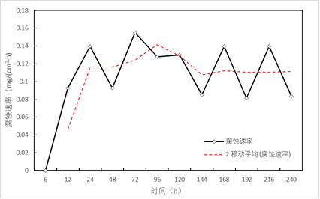
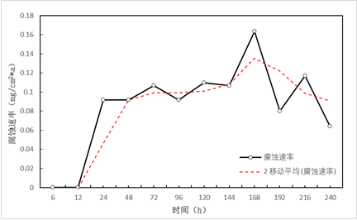
The corrosion rate curve of double layer Ni-P coating in 5 wt% NaCl solution
The corrosion rate curve of single layer Ni-P coating (high-phosphorus) in 5 wt% NaCl solution

Slide 7
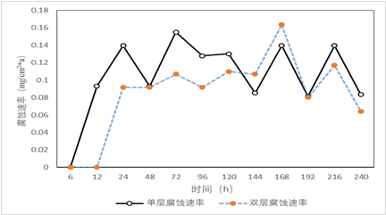
Comparison of Corrosion Rate Curve in 5wt% NaCl Solution

Slide 8
THE BEST
LAYER
1. The results showed that the performance of acid and salt resistance of the single layer Ni-P coating with high phosphorus content is better than the single layer Ni-P coating with low phosphorus content
2.The results showed that the performance of acid and salt resistance of the double layer Ni-P coating is better than the single layer Ni-P coating with high phosphorus content.

Slide 9
thanks

